Slide 1
Product Knowledge Training

Slide 2
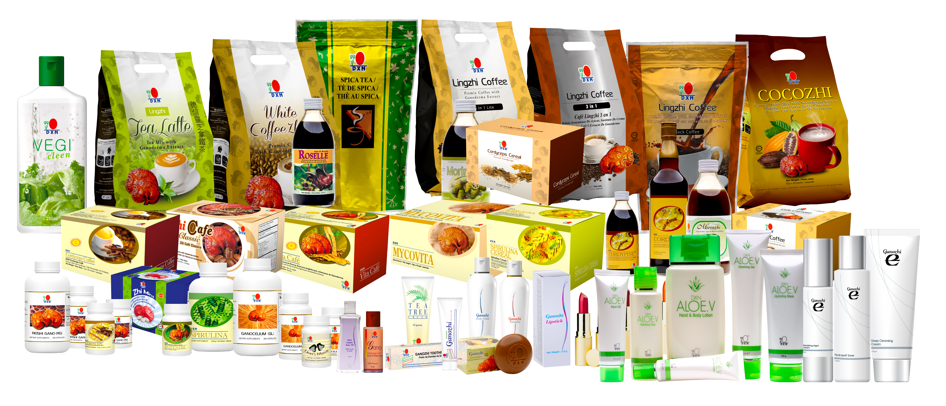
Product Knowledge Training
Food and dietary supplement products sold by Daxen are intended to contribute to the daily diet and overall health and are not intended for use in the prevention, treatment, mitigation, or cure of any disease or health related condition. Consult an appropriately licensed health care practitioner for a medical history evaluation, diagnosis, treatment, and health recommendations.

Slide 3
Learning DXN Products
Learning the differentiation strategy
Learning the special features of the products
Learning about the food theories relating to the products
Learning about the product positioning for wellbeing
Learning the skill to use product knowledge for creating demand
Product Knowledge Training

Slide 4
Differentiation Strategy
What is the difference between DXN products and the products of other companies?
There are different categories of consumers
There are 2 extreme groups in between these categories
One extreme is mainly for price
Another extreme is mainly for quality DXN is selling quality products
Product Knowledge Training

Slide 5
Special Features of DXN Products
One Dragon Concept – One Total Company
Unique Production Technology
Fast Moving Consumable Products
Trend Setting Products
Product Knowledge Training

Slide 6
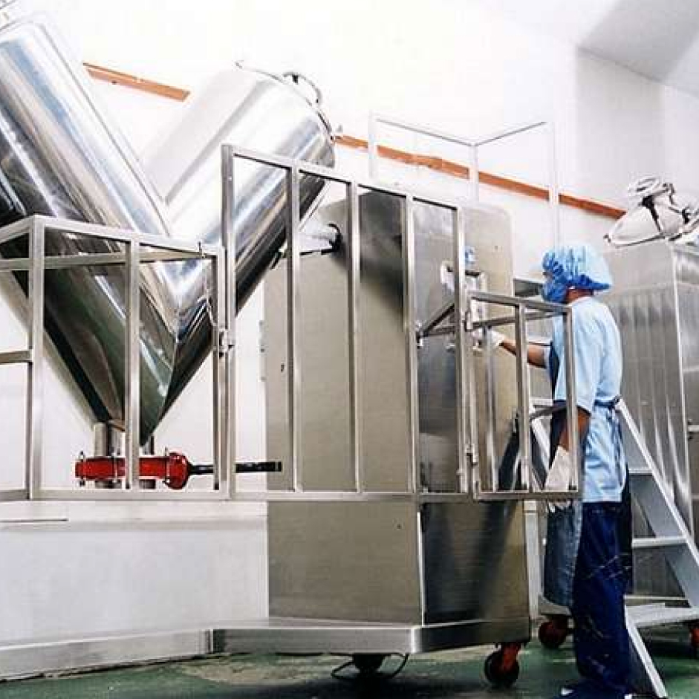
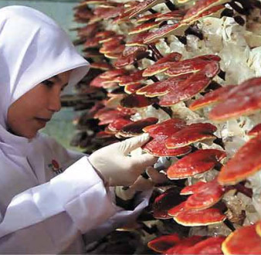
Company Profile
One Total Company
CULTIVATES
MANUFACTURES
DISTRIBUTES
Product Knowledge Training

Slide 7
One Dragon Concept
Objectives:
To control quality
To control cost
To research and develop own products
To ensure maximum payout as bonus
40% Manufacturing cost
60% on marketing, advertisement and outlets saved for bonus payment
Product Knowledge Training
Product Knowledge Training

Slide 8
Products
Unique DXN production technology
Tissue culture
Organic cultivation
Cold processing
Fiber separation
Micro / spore powderzation
Ultra violet treatment
Product Knowledge Training

Slide 9
Unique Production Technology
Tissue Culture to ensure generic values
Organic Cultivation to ensure natural values
Cold Processing to avoid heat treatment to preserve the properties of the ingredients
Fiber Separation to ensure high concentration
Micro/spore Powderization to ensure high nutrient absorption rate
Ultra Violet Treatment to remove moisture
Product Knowledge Training
Product Knowledge Training

Slide 10
Create Demand
To increase bonus, increase sales
To increase sales, create demand
To create demand, product knowledge is needed
To provide product knowledge, food theories need to be understood
How to Create
Demand?
Using food theories to create demand for products, thus increase sales and bonus
Product Knowledge Training

Slide 11
Food Theory
The Acidic vs Alkaline Theory
The Enzyme Theory
The Green Theory The
What Is Good For Your Stomach Is Good For Your Face Theory
The Formula For 4+1+1+10
Product Knowledge Training

Slide 12
ACIDIC vs ALKALINE
Human body needs to eat alkaline food and acidic food in the ratio of 4:1
Modern eating habits is just the reverse
Acidic foods:
Alkaline food:
Meat, Soft drinks, processed foods, sugar, Pork, Alcohol, Coffee & Black Tea, etc.
Sorghum, Millet, Wheat, Corn and Vegetables.
Consume DXN alkaline food like RG/GL, Spica Tea, Lingzhi Coffee, Spirulina & Morinzhi
Food and dietary supplement products sold by Daxen are intended to contribute to the daily diet and overall health and are not intended for use in the prevention, treatment, mitigation, or cure of any disease or health related condition. Consult an appropriately licensed health care practitioner for a medical history evaluation, diagnosis, treatment, and health recommendations.
Product Knowledge Training

Slide 13
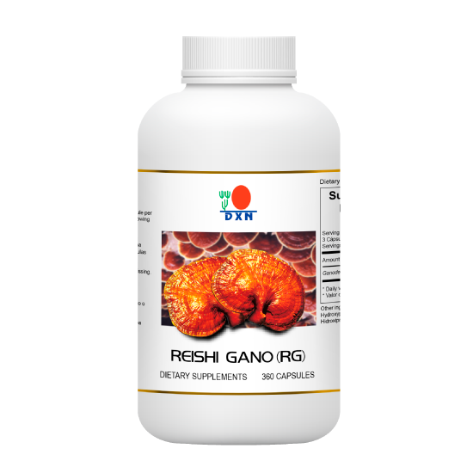
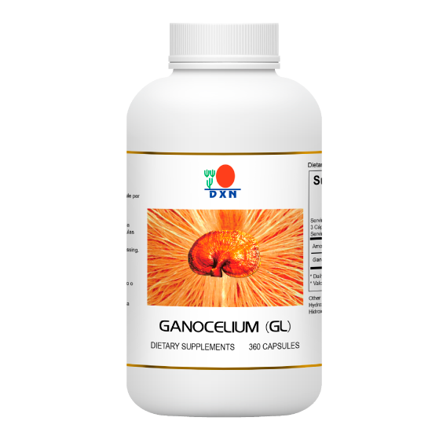
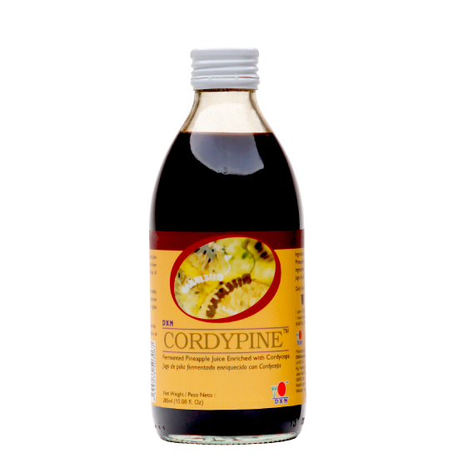
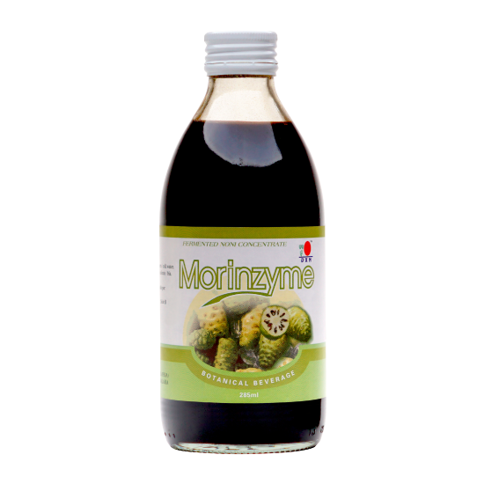
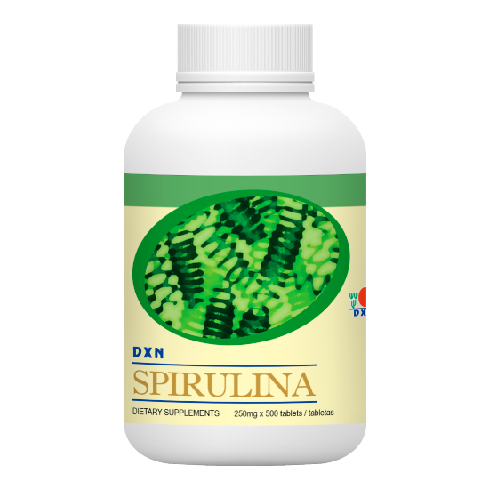
ENZYME THEORY
Diabetes is not the Problem; the Food is
Diabetes Problem
is caused by
Pancreas Problem
is caused by
Digestive Problem
is caused by
Food Problem
Consume:
RG/GL, Spirulina, Morinzyme and Cordypine
is caused by
Lack Enzyme
Food and dietary supplement products sold by Daxen are intended to contribute to the daily diet and overall health and are not intended for use in the prevention, treatment, mitigation, or cure of any disease or health related condition. Consult an appropriately licensed health care practitioner for a medical history evaluation, diagnosis, treatment, and health recommendations.
Product Knowledge Training

Slide 14
GREEN THEORY
The Cycle of Red Blood Production When red Blood Cell Dies
It is sent to
SPLEEN for decomposition
It is sent to
LIVER for further decomposition
It is sent to
KIDNEY which produces hormones
It is sent to
BONE MARROW to produce hemoglobin
It is sent to
Consume:
Spirulina.
RECYCLED RED BLOOD
Food and dietary supplement products sold by Daxen are intended to contribute to the daily diet and overall health and are not intended for use in the prevention, treatment, mitigation, or cure of any disease or health related condition. Consult an appropriately licensed health care practitioner for a medical history evaluation, diagnosis, treatment, and health recommendations.
Product Knowledge Training

Slide 15
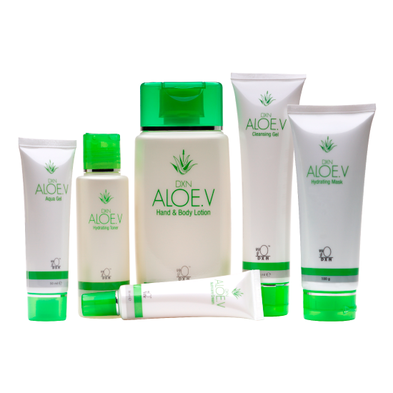
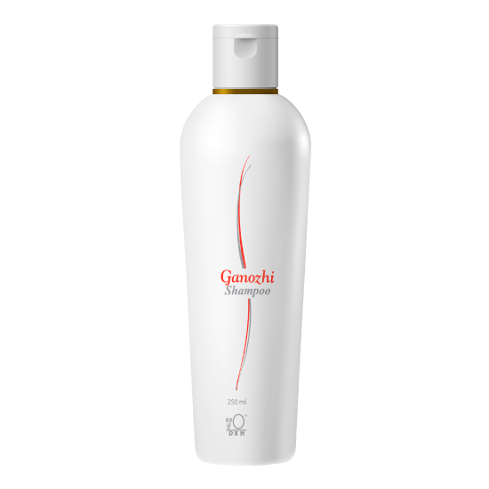
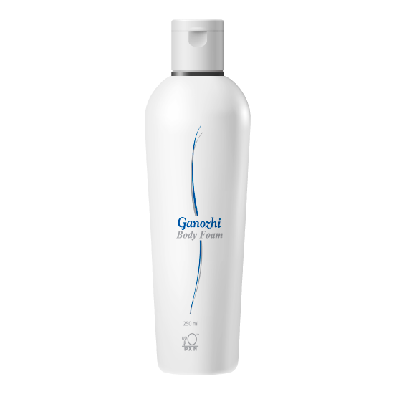
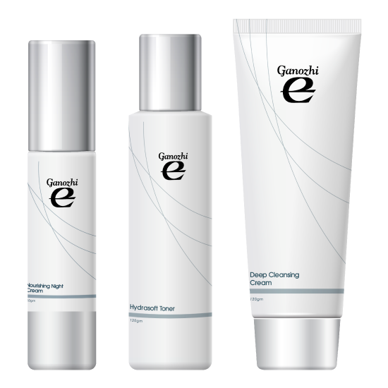
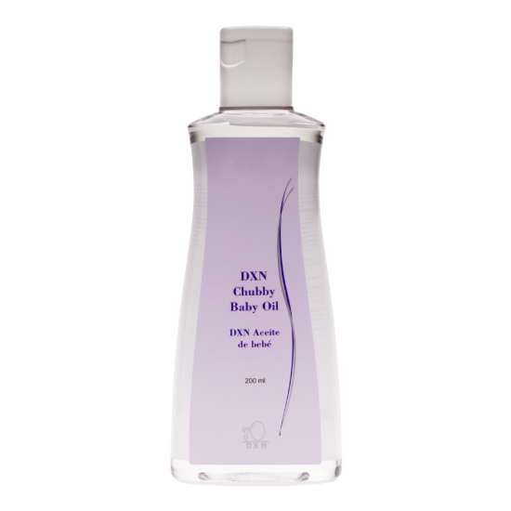
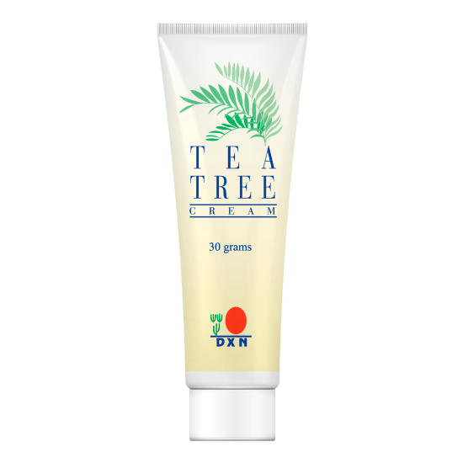
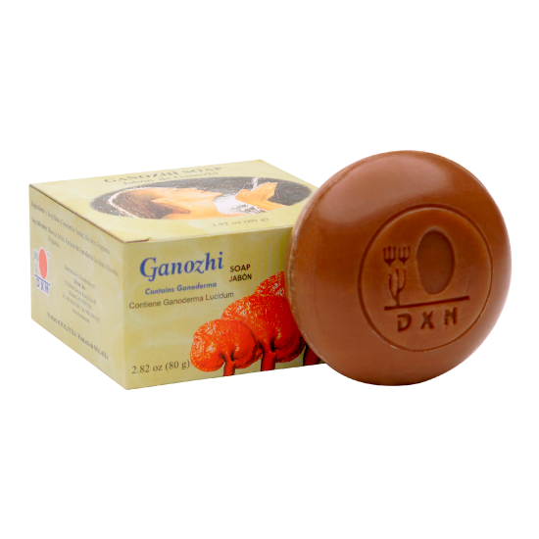
What is good For your stomach Is good for your face
Food and dietary supplement products sold by Daxen are intended to contribute to the daily diet and overall health and are not intended for use in the prevention, treatment, mitigation, or cure of any disease or health related condition. Consult an appropriately licensed health care practitioner for a medical history evaluation, diagnosis, treatment, and health recommendations.
Product Knowledge Training

Slide 16
The 4+1+1+10 Formula
Using:
4 Capsules of GL
1 sachet of Lingzhi Coffee 3 In 1
1 Spoonful fo Morinzyme/Morinzhi
10 Tablets of Spirulina Will help to boost up energy
Product Knowledge Training

Slide 17
PRODUCT POSITIONING
Circulation
Energy +
Waste
Oxygen + Nutrition
Cell
Problem
Solution
Toxin
Free Radical
Stress
Modern Lifestyle
Eating Habit
Mal-Nutrition
The “No Money No Time”Syndrome
DXN Products helps To provide the best support
Product Knowledge Training

Slide 18
Nutrition
Protein
Fat
Carbohydrate
Fiber
Water
Macro Nutrition
Energy Carrying Nutrient
Nutrition
Vitamin
Mineral
Trace Element
Enzyme
Phyto-nutrient
Chlorophyll
Micro Nutrition
Enable Cells To Extract Energy From Macro Nutrient
Product Knowledge Training

Slide 19
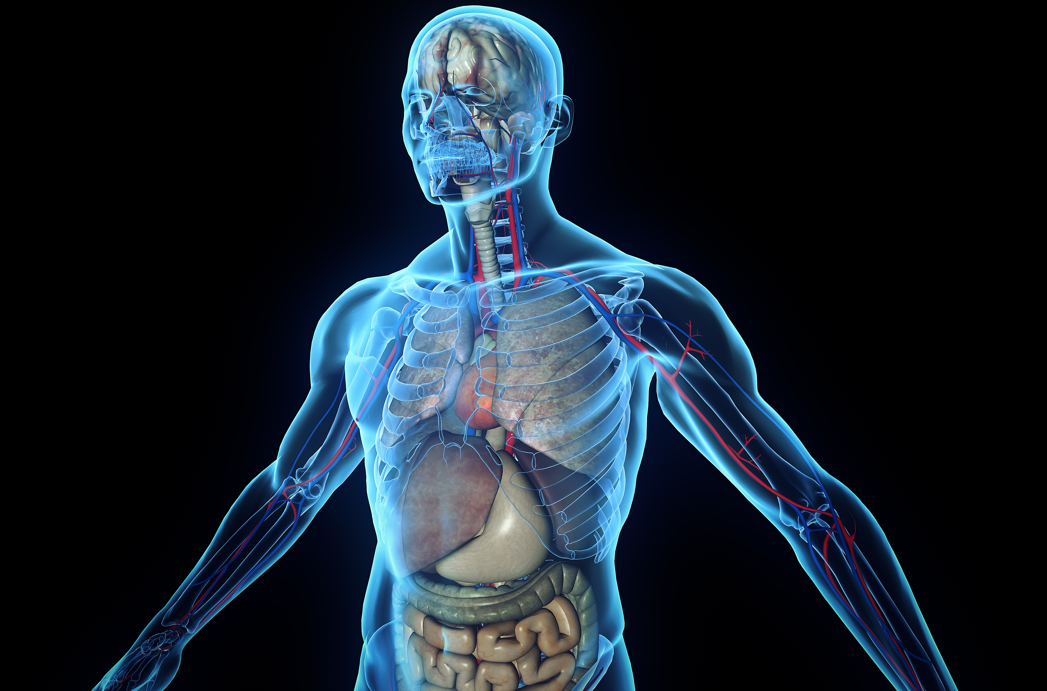
PRODUCT POSITIONING
Summary
The body is consist of bundle of cells
The body is like a car; it needs maintenance
The body is exposed to tortures
The body is fighting against the garbage within
The body is losing the battle
The body cannot talk to us
The body needs support
DXN Products provide the best support
Product Knowledge Training

Slide 20
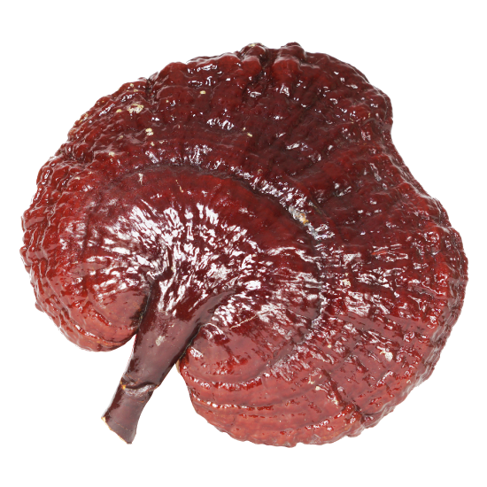
Ganoderma
Major Active Elements :
Polysaccharides
Organic Germanium
Adenosine
Triterpenoids
Ganoderic Essence
More than 400 elements
Product Knowledge Training

Slide 21
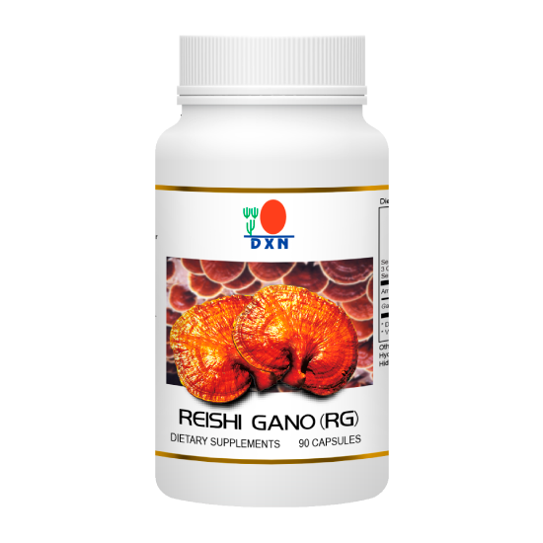
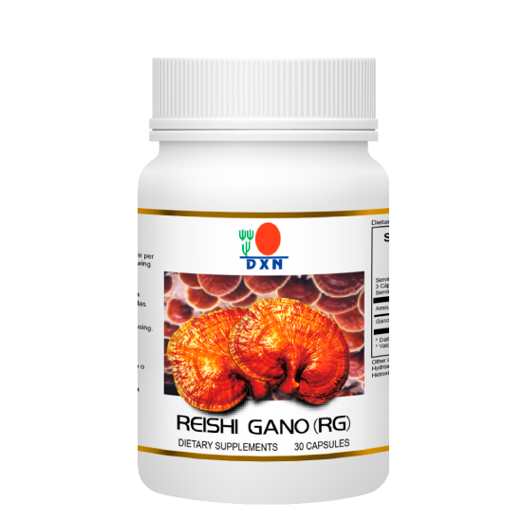
RG Is More Potent In
Triterpenoids
Adenosine
Polysaccharides
RG For Detoxification
Food and dietary supplement products sold by Daxen are intended to contribute to the daily diet and overall health and are not intended for use in the prevention, treatment, mitigation, or cure of any disease or health related condition. Consult an appropriately licensed health care practitioner for a medical history evaluation, diagnosis, treatment, and health recommendations.
Product Knowledge Training

Slide 22
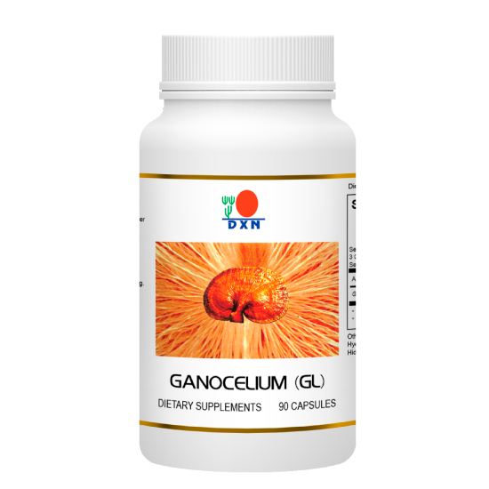
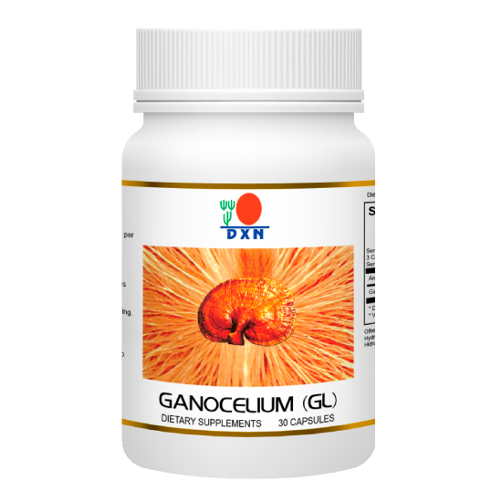
GL Is More Potent In
Organic Germanium
Ganoderic Acid
Polysaccharides
Minerals
Vitamins
GL For Balancing
Food and dietary supplement products sold by Daxen are intended to contribute to the daily diet and overall health and are not intended for use in the prevention, treatment, mitigation, or cure of any disease or health related condition. Consult an appropriately licensed health care practitioner for a medical history evaluation, diagnosis, treatment, and health recommendations.
Product Knowledge Training

Slide 23
Spirulina
Benefits:
Complete Food Source
Good Quality Protein
Good Quality Carbohydrate
Good Quality Fat
Good Quality Fiber
Good Quality Phytonutrients
Wide Range of Vitamins
Good Quality Chlorophyll
Food Orchestra:
Food and dietary supplement products sold by Daxen are intended to contribute to the daily diet and overall health and are not intended for use in the prevention, treatment, mitigation, or cure of any disease or health related condition. Consult an appropriately licensed health care practitioner for a medical history evaluation, diagnosis, treatment, and health recommendations.
Product Knowledge Training

Slide 24
Adaptogen
Ganoderma is a powerful adaptogen
Dr. Hans Selye – Nobel Prize Winner
As an adaptogen, ganoderma
Is non-toxic
Not limited to special organs or tissues
Has overall normalising effect
Food and dietary supplement products sold by Daxen are intended to contribute to the daily diet and overall health and are not intended for use in the prevention, treatment, mitigation, or cure of any disease or health related condition. Consult an appropriately licensed health care practitioner for a medical history evaluation, diagnosis, treatment, and health recommendations.
Product Knowledge Training

Slide 25
Ganoderma
Different Approach Between Drug And Ganoderma
Drug
Ganoderma
Chemical / Synthetic
Side Effect
Cure
Target specific
Disease
Human technology
Single molecule
Over dose111
Natural
Ailment reflection
Prevention
Overall normalizing effect
Body Wellness
Natural technology
> 400 elements
Any usage/consumption
Food and dietary supplement products sold by Daxen are intended to contribute to the daily diet and overall health and are not intended for use in the prevention, treatment, mitigation, or cure of any disease or health related condition. Consult an appropriately licensed health care practitioner for a medical history evaluation, diagnosis, treatment, and health recommendations.
Product Knowledge Training

Slide 26
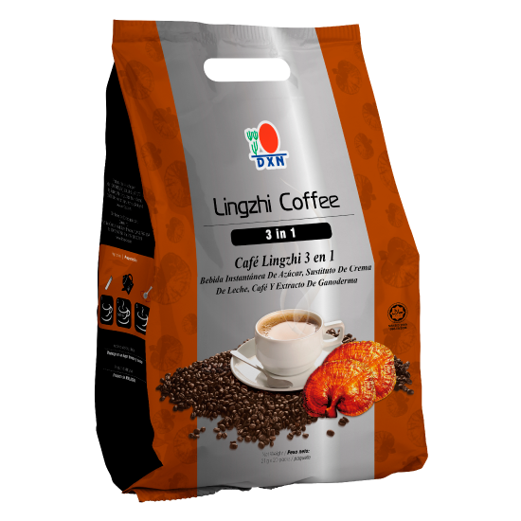
Lingzhi Coffee 3 In 1
1 + 1 = 11
Coffee
Ganoderma
Anti-stress
High Penetrating Power
Psychosomatic Effect
Diuretic Effect
Fast Consumable Food
Nutrition
Detoxification
Anti-oxidant
Adaptogen
Rich In Enzyme
Food and dietary supplement products sold by Daxen are intended to contribute to the daily diet and overall health and are not intended for use in the prevention, treatment, mitigation, or cure of any disease or health related condition. Consult an appropriately licensed health care practitioner for a medical history evaluation, diagnosis, treatment, and health recommendations.
Product Knowledge Training

Slide 27
Lingzhi Coffee 3 In 1
1 + 1 = 11
Coffee
Ganoderma
Anti-stress
High Penetrating Power
Psychosomatic Effect
Diuretic Effect
Fast Consumable Food
Nutrition
Detoxification
Anti-oxidant
Adaptogen
Rich In Enzyme
Alkaline In Nature
Food and dietary supplement products sold by Daxen are intended to contribute to the daily diet and overall health and are not intended for use in the prevention, treatment, mitigation, or cure of any disease or health related condition. Consult an appropriately licensed health care practitioner for a medical history evaluation, diagnosis, treatment, and health recommendations.
Product Knowledge Training

Slide 28
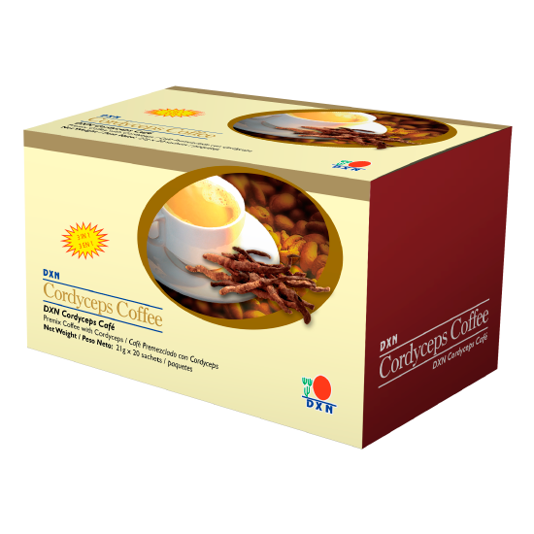
DXN Cordyceps Coffee 3 in 1
DXN Cordyceps Coffee 3 in 1 is specially formulated from instant coffee powder added with Cordyceps extract. This unique formulation makes a smooth and aromatic coffee to zest up your day.
Food and dietary supplement products sold by Daxen are intended to contribute to the daily diet and overall health and are not intended for use in the prevention, treatment, mitigation, or cure of any disease or health related condition. Consult an appropriately licensed health care practitioner for a medical history evaluation, diagnosis, treatment, and health recommendations.
Product Knowledge Training

Slide 29
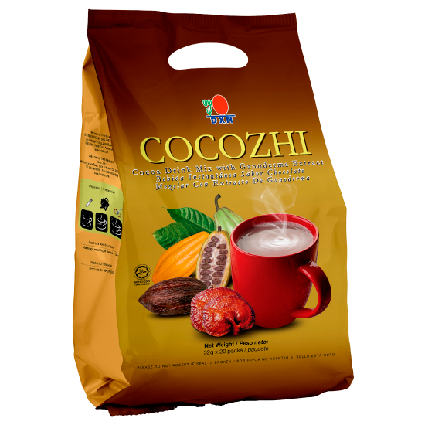
Cocozhi
Benefits:
Nutritional values
Antioxidant
Alkaline Drink
Enzyme Drink
Comparison with soft drink
Features:
Contains Ganoderma and Cocoa
Cocoa bean from the Theobroma Cacao Tree
It is natural
Food and dietary supplement products sold by Daxen are intended to contribute to the daily diet and overall health and are not intended for use in the prevention, treatment, mitigation, or cure of any disease or health related condition. Consult an appropriately licensed health care practitioner for a medical history evaluation, diagnosis, treatment, and health recommendations.
Product Knowledge Training

Slide 30
Cocozhi
Soft Drink
Acidic
Contain Free Radicals
Empty Calorie
Poor Nutrition
Cocozhi
Alkaline
Non Free Radical
Low Calorie
Good Nutrition
Food and dietary supplement products sold by Daxen are intended to contribute to the daily diet and overall health and are not intended for use in the prevention, treatment, mitigation, or cure of any disease or health related condition. Consult an appropriately licensed health care practitioner for a medical history evaluation, diagnosis, treatment, and health recommendations.
Product Knowledge Training

Slide 31
DXN Lingzhi Coffee 3 in 1
DXN Lingzhi Coffee 3 in 1 is specially blended with Finest Quality Coffee Powder & 100% Pure GANODERMA. No Artificial Coloring & Preservatives.
Contains sugar and low fat cream Reduces Stress in Daily Life
Food and dietary supplement products sold by Daxen are intended to contribute to the daily diet and overall health and are not intended for use in the prevention, treatment, mitigation, or cure of any disease or health related condition. Consult an appropriately licensed health care practitioner for a medical history evaluation, diagnosis, treatment, and health recommendations.
Product Knowledge Training

Slide 32
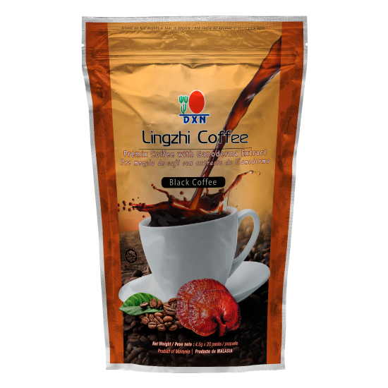
DXN Lingzhi 2 In 1 Black Coffee
DXN Lingzhi 2 In 1 Black Coffee Contains GANODERMA Extract. The Ingredients are easily Dissolved & Produce an Excellent Aromatic Beverage. One Cup Lingzhi 2 in 1 Coffee Refreshes your Mood. No sugar, no milk added. Help Diabetic patients and reduces joint pain.
Food and dietary supplement products sold by Daxen are intended to contribute to the daily diet and overall health and are not intended for use in the prevention, treatment, mitigation, or cure of any disease or health related condition. Consult an appropriately licensed health care practitioner for a medical history evaluation, diagnosis, treatment, and health recommendations.
Product Knowledge Training

Slide 33
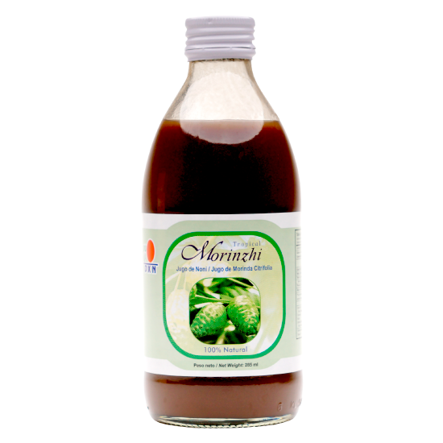
Morinzhi
Features:
Made from Noni fruit and Roselle fruit
Own cultivation
Manufactured in-house
Rich in natural ingredients
No additives, artificial flavoring, coloring and preservatives
Benefits:
Enhances digestion
Helps improve blood circulation
Helps to neutralize free radicals
Helps to support the defense system
Helps to lower blood pressure
Food and dietary supplement products sold by Daxen are intended to contribute to the daily diet and overall health and are not intended for use in the prevention, treatment, mitigation, or cure of any disease or health related condition. Consult an appropriately licensed health care practitioner for a medical history evaluation, diagnosis, treatment, and health recommendations.
Product Knowledge Training

Slide 34
DXN MycoVeggie
It is a mixture of vegetables, mushrooms, herbs and spices
Min. Net Weight / 400 g
MycoVeggie is a specially formulated high dietary fibre food supplement mixed from a wide range of vegetables, mushrooms, herbs and spices. It is sugar-free, cholesterolfree, low in fat and sodium and contains various nutrients. MycoVeggie is an easy-to-serve supplement anytime and anywhere
Ingredients Psyllium grain, celery, mulberry leaf, noni leaf, gingko leaf, ginger, lemon grass, shiitake mushroom, lyophillum mushroom, st. george’s mushroom, lion’s mane mushroom, elm oyster mushroom, grey oyster mushroom, split gill mushroom, sweet corn, lime, orange, Spirulina, green tea, pericarpium citri reticulatea, cinnamon, star anise and clove
Preparation instructions
Mix 1 scoop (5 g) of MycoVeggie with a glass of cold or warm water. Stir well and consume immediately
Food and dietary supplement products sold by Daxen are intended to contribute to the daily diet and overall health and are not intended for use in the prevention, treatment, mitigation, or cure of any disease or health related condition. Consult an appropriately licensed health care practitioner for a medical history evaluation, diagnosis, treatment, and health recommendations.
Product Knowledge Training

Slide 35
Personal Care Products
Skin - The largest organ
The largest detoxification organ
The most neglected organ
It is sensitive to pain and touch
It is protective
It regulates body temperature
Food and dietary supplement products sold by Daxen are intended to contribute to the daily diet and overall health and are not intended for use in the prevention, treatment, mitigation, or cure of any disease or health related condition. Consult an appropriately licensed health care practitioner for a medical history evaluation, diagnosis, treatment, and health recommendations.
Product Knowledge Training

Slide 36
DXN Aloe V
Special Features:
Natural
Nutrition
Anti-oxidant
PH Balancer
Food and dietary supplement products sold by Daxen are intended to contribute to the daily diet and overall health and are not intended for use in the prevention, treatment, mitigation, or cure of any disease or health related condition. Consult an appropriately licensed health care practitioner for a medical history evaluation, diagnosis, treatment, and health recommendations.
Product Knowledge Training

Slide 37
Ganozhi Soap
Made from Palm Oil and Ganoderma Increase the penetrating power Body Soap Baby Soap Shaving Soap Health Soap
PH Balancer Skin PH is between 4.5 – 6.5
Food and dietary supplement products sold by Daxen are intended to contribute to the daily diet and overall health and are not intended for use in the prevention, treatment, mitigation, or cure of any disease or health related condition. Consult an appropriately licensed health care practitioner for a medical history evaluation, diagnosis, treatment, and health recommendations.
Product Knowledge Training

Slide 38
DXN Gano Massage Oil
100% Pure Palm Oil With Gano Extract
Best Relief For Tired Muscles And Legs
Hair & Body Hot Oil Treatment.
Also A Handy First Aid Treatment.
Food and dietary supplement products sold by Daxen are intended to contribute to the daily diet and overall health and are not intended for use in the prevention, treatment, mitigation, or cure of any disease or health related condition. Consult an appropriately licensed health care practitioner for a medical history evaluation, diagnosis, treatment, and health recommendations.
Product Knowledge Training

Slide 39
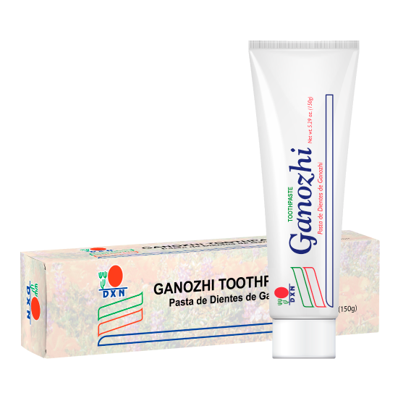
DXN Ganozhi™ Toothpaste- ( 75g / tube )
DXN Ganozhi™ Toothpaste contains no saccharin and colouring but with high quality of Ganoderma extract, food gel, menthol and food flavouring. It can effectively cleanse your teeth for fresh breath and taste in your mouth. It also makes your teeth healthier and brighter.
Food and dietary supplement products sold by Daxen are intended to contribute to the daily diet and overall health and are not intended for use in the prevention, treatment, mitigation, or cure of any disease or health related condition. Consult an appropriately licensed health care practitioner for a medical history evaluation, diagnosis, treatment, and health recommendations.
Product Knowledge Training

Slide 40
DXN Products
DXN Products Are
Natural
For Wellness
Unique of Its Kind
Quality Premium Products
Fast Moving Consumable Products
Reliable
Affordable
Trend Setter
Business Oriented
Be A Product of The Products!
(No Approved Therapeutic Claims)
Food and dietary supplement products sold by Daxen are intended to contribute to the daily diet and overall health and are not intended for use in the prevention, treatment, mitigation, or cure of any disease or health related condition. Consult an appropriately licensed health care practitioner for a medical history evaluation, diagnosis, treatment, and health recommendations.
Product Knowledge Training

Slide 41
Products Future
The World Health Organization ( WHO ) estimates the size of the global market for herbal products at
USD 80 billion in the year 2000
USD 200 billion in the year 2008
USD 50 trillion in the year 2050
Product Knowledge Training

Slide 42
Thank You
Let’s Join Hands to Promote a Healthy, Wealthy Society
Product Knowledge Training

